Slide 1

Introduction to Academic Writing
Academic writing is a specific type of writing that uses formal language and structure. It focuses on presenting information and research in a clear and concise manner.

Slide 2

Sentence Structure
Sentences in academic writing should be grammatically correct and well-constructed. They should be complete thoughts and follow a clear subject-verb-object structure.
1
Active Voice
2
Passive Voice
3
Conciseness
The subject of the sentence performs the action.
The action is performed on the subject.
Avoid unnecessary words and phrases.

Slide 3
Paragraph Structure
Paragraphs in academic writing should be organized and logical.
Each paragraph should focus on a single idea and have a clear topic sentence.
Point
Evidence
Explain
Link
1
Topic Sentence
The main idea of the paragraph, often the first sentence.
2
Supporting Sentences
Provide evidence and elaboration to support the topic sentence.
3
Concluding Sentence
Summarizes the main point of the paragraph and transitions to the next.

Slide 4



Verb Tense Consistency
Maintaining consistent verb tense throughout your writing is essential for clarity and accuracy. Use the tense that best suits the context of your writing.
Present Tense
Describes actions happening now.
Past Tense
Describes actions that happened in the past.
Future Tense
Describes actions that will happen in the future.

Slide 5
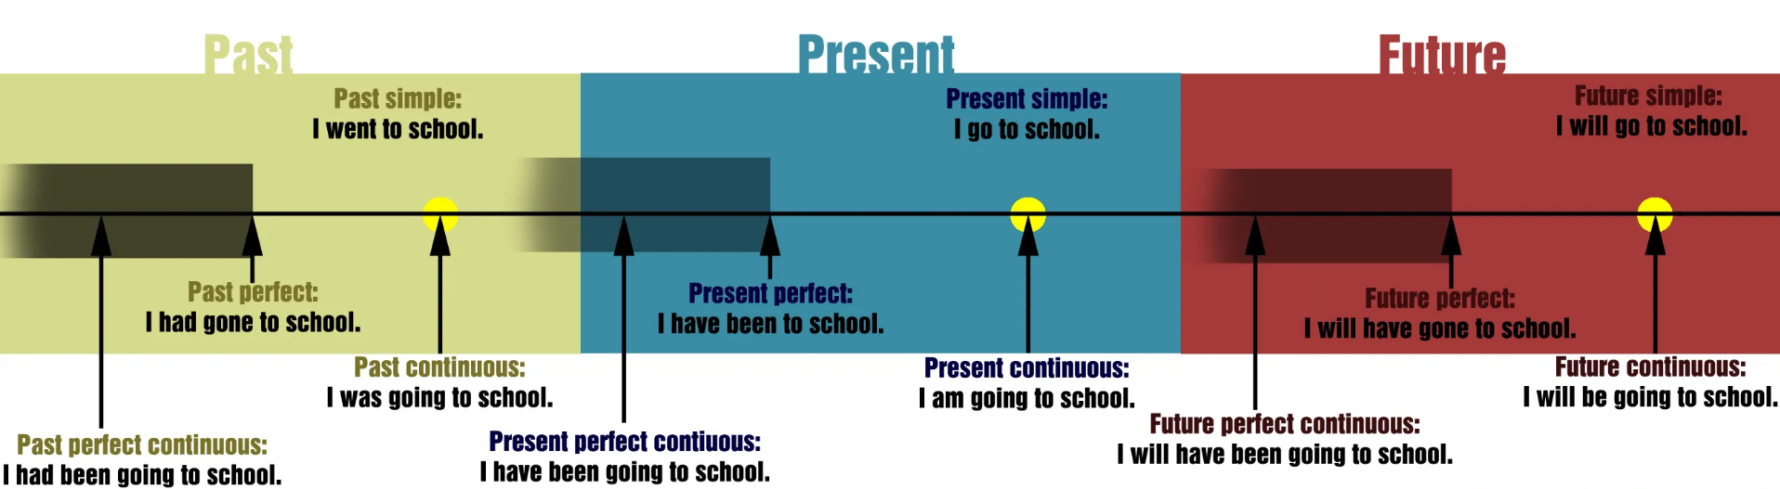
Verb Tense Consistency

Slide 6

Subject-Verb Agreement
Subjects and verbs must agree in number (singular or plural). This means a singular subject takes a singular verb, and a plural subject takes a plural verb.
Singular Subject
Plural Subject
The student writes a paper.
The students write papers.

Slide 7
Practice:
Underline the subject (or compound subject) and then identify the verb that agrees with it.
Example:
Everyone in the telecom focus group (has/have) experienced problems with cell phones
Your friendship over the years and your support (has/have) meant a great deal to us.
Hamilton Family Center, a shelter for teenage runaways in San Francisco, (offers/offer) a wide variety of services.
The main source of income for Trinidad (is/are) oil and pitch.
The chances of your being promoted (is/are) excellent.
There (was/were) a Pokémon card stuck to the refrigerator.
Neither the professor nor his assistants (was/were) able to solve the mystery of the eerie glow in the laboratory.
Many hours at the driving range (has/have) led us to design golf balls with GPS locators in them.
The board of directors, ignoring the wishes of the neighbourhood, (has/have) voted to allow further development
Every year, during the midsummer festival, the smoke of village bonfires (fills/fill) the sky.
The story performers (was/were) surrounded by children and adults eager to see magical tales.

Slide 8



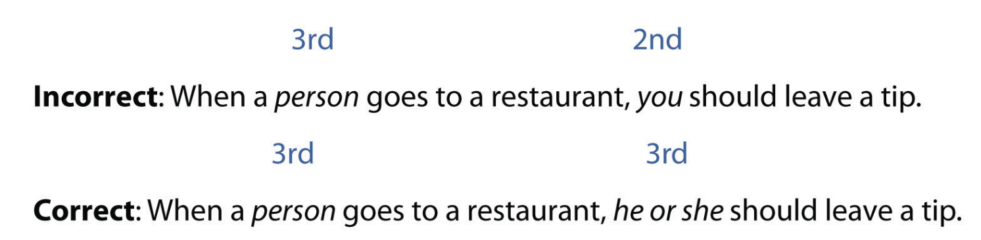

Pronoun Usage
Pronouns should clearly refer to their antecedents (the nouns they replace). Pronouns should also agree in gender and number with their antecedents.
Clear Reference
Agreement
Specificity
Ensure pronouns agree with their nouns in gender and number.
Use specific pronouns instead of vague ones.
Avoid ambiguous pronoun references.
Do not use 1st (I, we) or 2nd (you) person pronouns

Slide 9

Practice:
Which of the following sentences is correct and which is not.
Tina and Arial went to the mall after she finished her exam.
Tina and Arial went to the mall after she finished their exam.
Tina and Arial went to the mall after they finished their exam.
Tina and Arial went to the mall after Arial finished her exam.
Tina and Arial went to the mall after Tina finished her exam.
Tina and Arial went to the mall after they finished her exam.

Slide 10
Practice:
Complete the following sentences by selecting the correct pronoun.
In the current economy, nobody wants to waste ________ money on frivolous things.
If anybody chooses to go to medical school, ________ must be prepared to work long hours.
The plumbing crew did ________ best to repair the broken pipes before the next ice storm.
If someone is rude to you, try giving ________ a smile in return.
My family members have ________ mistakes, but I still love them no matter what.
The school of education plans to train ________ students to be literacy tutors.
The commencement speaker said that each student has a responsibility toward ________.
My mother’s singing group has ________ rehearsals on Thursday evenings.
Dana should not suffer ________ pain alone.
I thought the flock of birds lost ________ way in the storm.
their
they
their
them
their
its
themselves
its
her
its

Slide 11

Avoiding Passive Voice
Passive voice often makes writing wordy and indirect. Active voice is generally preferred in academic writing because it is more direct and concise.
Passive Voice
The experiment was conducted by the researchers.
Active Voice
The researchers conducted the experiment.

Slide 12
Practice:
Determine if these sentences are in the active (A) or passive voice (P).
A
The coffee was still boiling after the waiter served it.
The students worked on their papers all night.
The wind was making the tree sway.
Her hand was held up to answer the question.
The three dogs were being walked.
The earth continually spins on its axis.
The students were released from class.
Nathaniel gave his speech flawlessly.
Without interruption, the scarf was knit by Margot.
We were driven to the beach by Caleb in his minivan.
The class was taught by Heather in the evenings.
Café Moka closed early, so Danielle brewed her own pot of coffee.
The professor and her aid passed out the exam which the students took.
Griff explained the importance of proofreading one’s sentences.
The exercise sheet was finished by you!
A
A
P
P
A
P
A
P
P
P
A
A
A
P

Slide 13

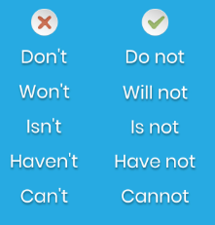
Avoiding Contractions and Colloquialisms
Academic writing requires formal language.
Formal Language
Avoid Slang
Avoid Contractions
Use proper grammar and vocabulary.
Use standard English.
colloquialisms (slang words or phrases) to maintain a professional tone.
Write out full words.
Avoid contractions (can't, don't)

Slide 14
Practice:
Spot the mistakes in the following paragraph and fix them.
5G technology is revolutionizing the way we connect to the internet, and it's bringing fast speeds that allow data to be transferred more quickly than ever. It’s not only improving our mobile networks, but it’s also allowing for devices to connect better. These faster speeds makes it easier for people to stream, download, and communicate in real-time. With 5G, cities and businesses is now able to build smarter systems that can handle more traffic without slowing down. It’s rollout happened faster than experts anticipated, and we expect 5G technology to change the way our industries operates.
5G technology is revolutionizing the way people connect to the internet, and it is bringing fast speeds that allow data to transfer more quickly than ever. It is not only improving people’s mobile networks, but it is also allowing devices to connect better. These faster speeds make it easier for people to stream, download, and communicate in real time. With 5G, cities and businesses are now able to build smarter systems that can handle more traffic without slowing down. Its rollout happened faster than experts anticipated, and people expect 5G technology to change the way industries operate.

Slide 15



